Slide 1
Immune Cell Receptor Profiling of scRNA seq for Covid-19

Slide 2
Agenda
Immune system background
About the paper
File format and data generation
Marker genes visualization
Differential gene expression
Gene set enrichment analysis

Slide 3
Agenda
Immune system background
About the paper
File format and data generation
Marker genes visualization
Differential gene expression
Gene set enrichment analysis

Slide 4
Immune system background

Slide 5
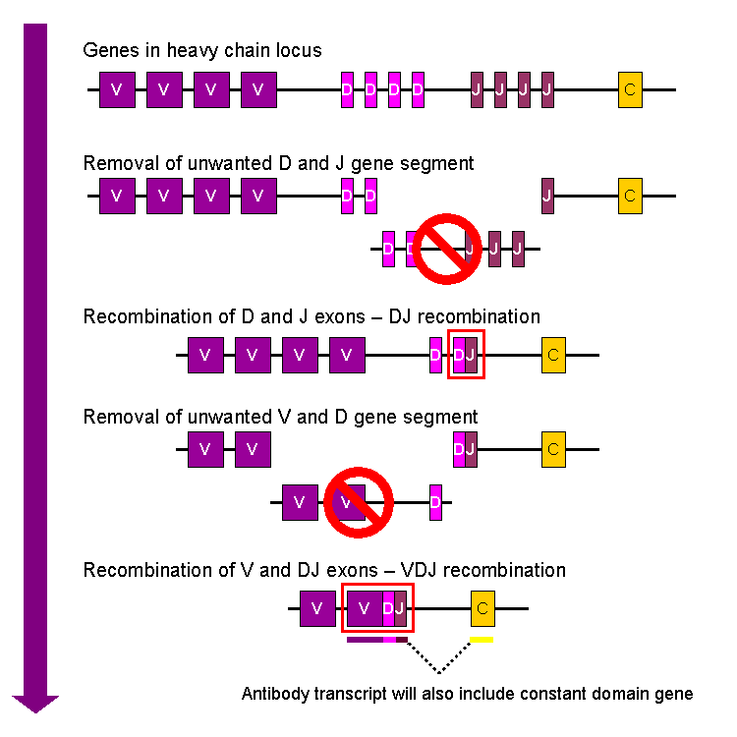
B-Cells (Ig)
After maturation, B cells move to lymphatic system
Naive B cell in the lymphatic system encounters an antigen and starts the maturation process
B cells is activated and undergoes clonal expansion
Some of the b cell differentiate into Plasma cells
Antibodies specific to antigen is secreted
Recognition and elimination mechanism
Antigen that bind to the surface of ig
Stem cells in bone marrow. B cells formed here
Immunoglobulin VDJ recombination occurs in developing B-lymphocytes in the bone marrow during the early stages of B-cell differentiation leading to the formation of a functional Ig gene that encodes a unique antibody.it also introduces variability into the antibody gene through the creation of random mutations at the junctions of the joined segments, further increasing the diversity of the B-cell repertoire.
The association of the rearranged V domain with a particular C domain determines the class or isotype of the antibody, such as IgM, IgG, IgA, etc
For ig

Slide 6
B-Cells (Ig)
Naive B cell in the lymphatic system encounters an antigen and starts the maturation process
B cells is activated and undergoes clonal expansion
After maturation, B cells move to lymphatic system
Antibodies specific to antigen is secreted
Recognition and elimination mechanism
Stem cells in bone marrow. B cells formed here
Some of the b cell differentiate into Plasma cells
Antigen that bind to the surface of ig
Immunoglobulin VDJ recombination occurs in developing B-lymphocytes in the bone marrow during the early stages of B-cell differentiation leading to the formation of a functional Ig gene that encodes a unique antibody.
Introduces variability into the antibody gene through the creation of random mutations at the junctions of the joined segments, further increasing the diversity of the B-cell repertoire.

Slide 7
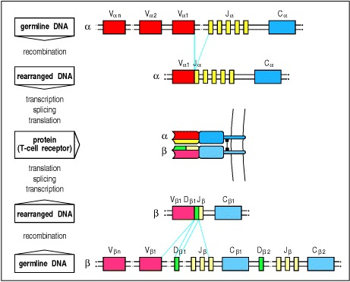
T Cells
Stem cells in bone marrow. B T cells formed here
T cells move to thymus,and starts to express tcr and cd4 or cd8 receptors
While in thymus,TCR genes, located on the T cell chromosome, undergo rearrangement to generate a unique TCR gene.This is the maturation process.
Activated by antigen present on the apc , by recognizing the antigen mhc(mhc1/mhc2)complex(Mature T cells should recognize only foreign antigens combined with self-MHC molecules for an appropriate immune response)
Clonal expansion
Tc Th treg
C domain of the TCR provides structural stability and modulates the biologic properties of the TCR, such as its affinity for antigens and its ability to signal the T-cell to undergo activation and differentiation
For tcr
Recognition and elimination mechanism

Slide 8
T Cells
Stem cells in bone marrow. T cells formed here
T cells move to thymus,and starts to express tcr and cd4 or cd8 receptors
While in thymus,TCR genes, located on the T cell chromosome, undergo rearrangement to generate a unique TCR gene.This is the maturation process.
Activated by antigen present on the apc , by recognizing the antigen mhc(mhc1/mhc2)complex
Mature T cells should recognize only foreign antigens combined with self-MHC molecules for an appropriate immune response
Clonal expansion
Tc Th treg
Recognition and elimination mechanism

Slide 9
Combinatorial diversity (V-(D)-J rearrangements), the junctional diversity (N-diversity and rarely P junction), the somatic hypermutations (SHM) (shm only for ig )and the pairing of the heavy and light chains.
C domain of the TCR provides structural stability and modulates the biologic properties of the TCR, such as its affinity for antigens and its ability to signal the T-cell to undergo activation and differentiation
During the transcription (mrna) in B or T cells, the rearranged V-(D)-J gene which codes the V domain is spliced to a C gene that codes the C region.
.
Vdomain is responsible for recognizing and binding to specific antigen
The association of the rearranged V domain with a particular C domain determines the class or isotype of the antibody, such as IgM, IgG, IgA, etc
For Ig
For TCR

Slide 10
Stem cells in bone marrow. B cells and T cells formed here
After maturation, B cells move to lymphatic system
Naive B cell in the lymphatic system encounters an antigen and starts the maturation process
B cells is activated and undergoes clonal expansion
Some of the b cell differentiate into Plasma cells
Antibodies specific to antigen is secreted
Recognition and elimination mechanism
Antigen that bind to the surface of ig
T cells move to thymus,and starts to express tcr and cd4 or cd8 receptors
Immunoglobulin VDJ recombination occurs in developing B-lymphocytes in the bone marrow during the early stages of B-cell differentiation leading to the formation of a functional Ig gene that encodes a unique antibody.it also introduces variability into the antibody gene through the creation of random mutations at the junctions of the joined segments, further increasing the diversity of the B-cell repertoire.
While in thymus,TCR genes, located on the T cell chromosome, undergo rearrangement to generate a unique TCR gene.This is the maturation process.
Activated by antigen present on the apc , by recognizing the antigen mhc(mhc1/mhc2)complex(Mature T cells should recognize only foreign antigens combined with self-MHC molecules for an appropriate immune response)
combinatorial diversity (V-(D)-J rearrangements), the junctional diversity (N-diversity and rarely P junction), the somatic hypermutations (SHM) (shm only for ig )and the pairing of the heavy and light chains.
Vdomain is responsible for recognizing and binding to specific antigen
Clonal expansion
During the transcription (mrna) in B or T cells, the rearranged V-(D)-J gene which codes the V domain is spliced to a C gene that codes the C region.
.
Tc Th treg
For ig
The association of the rearranged V domain with a particular C domain determines the class or isotype of the antibody, such as IgM, IgG, IgA, etc
Recognition and elimination mechanism
C domain of the TCR provides structural stability and modulates the biologic properties of the TCR, such as its affinity for antigens and its ability to signal the T-cell to undergo activation and differentiation
For tcr

Slide 12
Immune receptors:
T cell receptors (TCRs)
B cell receptors (BCRs)
Major histocompatibility complex (MHC) molecules
Interleukin-2 receptor (IL-2R)
Interleukin-4 receptor (IL-4R)
Interleukin-6 receptor (IL-6R)
Interleukin-17 receptor (IL-17R)
Interleukin-21 receptor (IL-21R)
Interleukin-23 receptor (IL-23R)
Interferon gamma receptor (IFNγR)
CD28 receptor
CTLA-4 receptor
TNF receptor
Fcγ receptors (FcγRs)

Slide 13
CD complexes serve as markers of cell type and activation state and are used to identify and distinguish different types of immune cells, such as T cells, B cells, monocytes, and dendritic cells. By measuring the expression levels of specific CD markers, it is possible to determine the types and subpopulations of immune cells present in a sample, as well as their activation state.(need flow cytometry data)
CDR complexes, on the other hand, are part of the antigen-binding site of antibodies and T cell receptors and contribute to the specificity of these receptors. By measuring the diversity of the CDR regions, it is possible to determine the specificities of the antibodies and T cell receptors present in a sample and to assess the overall diversity of the immune repertoire.

Slide 14
Immunoglobulin chains (IG) and T-cell receptor chains (TR) are generated by DNA recombination, a process of somatic rearrangement of variable (V), diversity (D), and joining (J) genes . The diversity of the resulting rearranged genes (referred as V-J and V-D-J) is very high, due to not only the combination of different germline V, D, and J genes, but also to the deletion and addition of templated (P) nucleotides and the addition of non-templated (N) nucleotides at the junctions between the rearranged genes, and somatic hypermutation of expressed IG.
The purpose is to conduct a comprehensive analysis of the immunogenetic profile of the light chain and heavy chain gene rearrangement of the gene repertoire and mutational status. The aim of the investigation is to uncover the putative role of CDR3 sequence, gene frequencies of individual genes, possible biases in gene usage and disease-biased features of gene repertoire.

Slide 15
SARS-CoV-2 in severe COVID-19 induces a TGF-β-dominated chronic immune response that does not target itself
The main findings of the paper are:
Severe COVID-19 patients have a chronic immune response that is dominated by the cytokine transforming growth factor beta (TGF-β), which is known to promote fibrosis and tissue damage.
Severe COVID-19 patients have a dysregulated B cell response, with reduced production of antibodies against SARS-CoV-2 and increased production of autoantibodies against self-antigens.
Severe COVID-19 patients have a reduced expression of genes involved in antiviral defense, such as interferons and their receptors, which may impair the clearance of SARS-CoV-2.
The paper concludes that severe COVID-19 patients have a TGF-β-dominated chronic immune response that does not target SARS-CoV-2 effectively, but rather causes collateral damage to the host. The paper suggests that targeting TGF-β or its downstream pathways may be a potential therapeutic strategy for severe COVID-19.

Slide 16
SARS-CoV-2 in severe COVID-19 induces a TGF-β-dominated chronic immune response that does not target itself
About The Paper
The main findings of the paper are:
Severe COVID-19 patients have a chronic immune response that is dominated by the cytokine transforming growth factor beta (TGF-β), which is known to promote fibrosis and tissue damage.
Severe COVID-19 patients have a dysregulated B cell response, with reduced production of antibodies against SARS-CoV-2 and increased production of autoantibodies against self-antigens.
Severe COVID-19 patients have a reduced expression of genes involved in antiviral defense, such as interferons and their receptors, which may impair the clearance of SARS-CoV-2.
The paper concludes that severe COVID-19 patients have a TGF-β-dominated chronic immune response that does not target SARS-CoV-2 effectively, but rather causes collateral damage to the host. The paper suggests that targeting TGF-β or its downstream pathways may be a potential therapeutic strategy for severe COVID-19.

Slide 17
Downstream analysis of scRNA
Sequencing:
Data preprocessing:
Read mapping and annotation:
Data analysis:
Visualization:

Slide 18
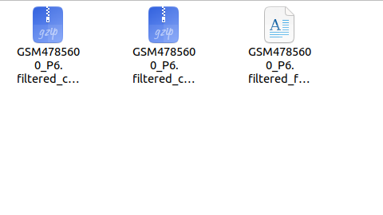
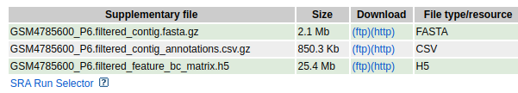
Data available for the paper
filtered contig FASTA file - scrna seq generates sequencing data for individual cells, resulting in a large number of short reads that need to be assembled into longer sequences called contigs.The resulting file, which contains only high-quality sequences, is called a filtered contig FASTA file.
filtered contig annotation - refers to the process of identifying and labeling the genes and features that are present in a set of high-quality contigs. The annotation of filtered contigs involves the comparison of the sequences to a reference genome or transcriptome to determine the gene identity and to assign functional annotations.
filtered barcode (BC) matrix is a data matrix that contains the number of unique molecular identifiers (UMIs) associated with each barcode and gene pair in single-cell RNA sequencing (scRNA-seq) data. The barcode refers to the unique identifier assigned to each cell during the scRNA-seq library preparation process, and the gene represents a specific RNA transcript.

Slide 19
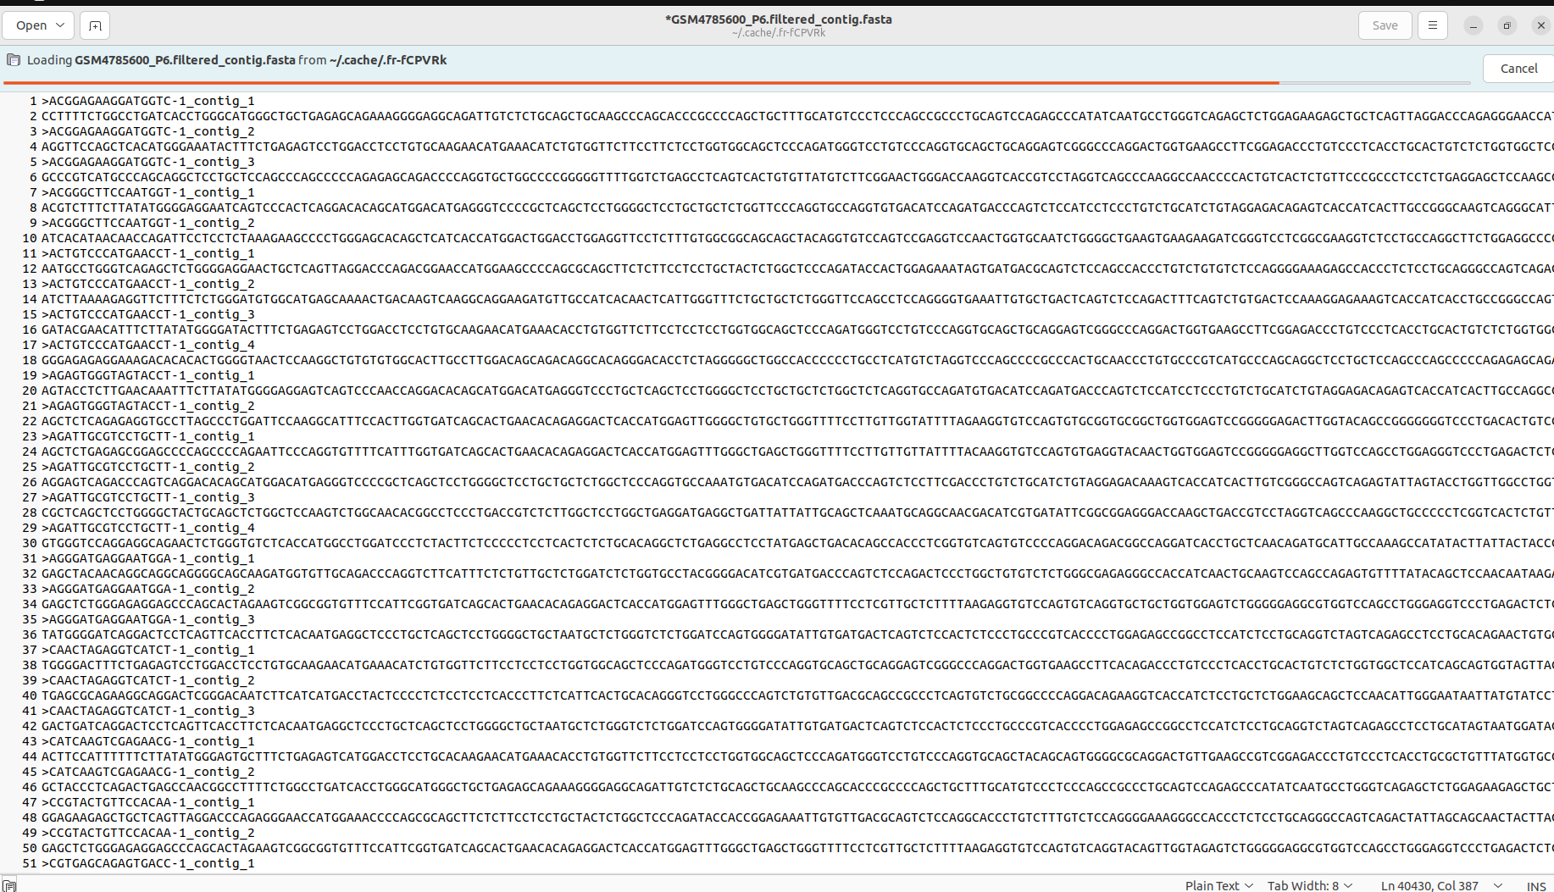

Slide 20
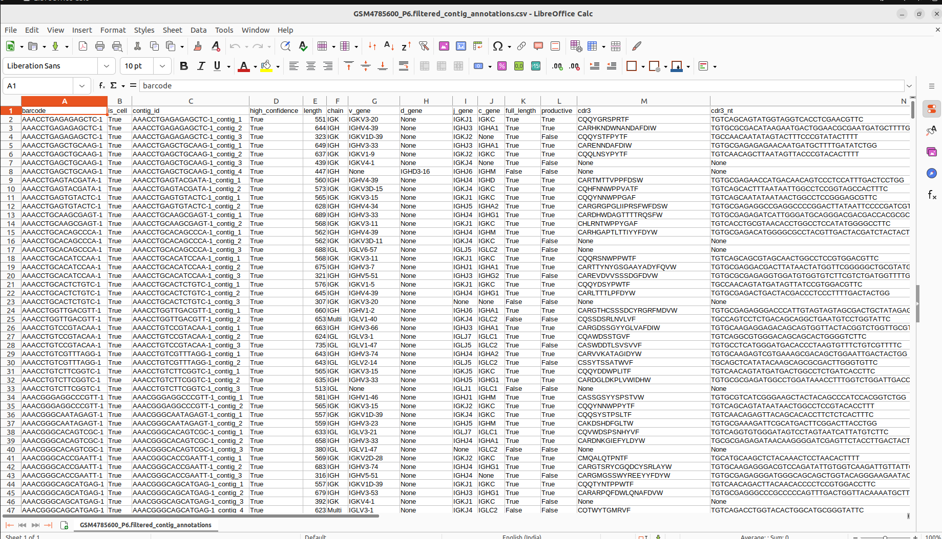

Slide 21
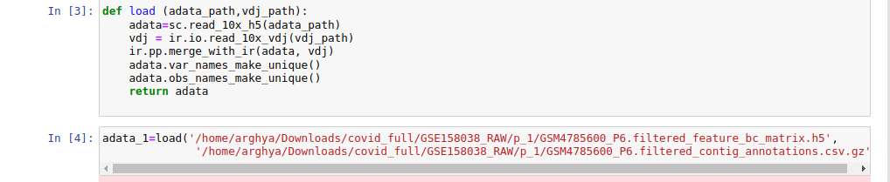
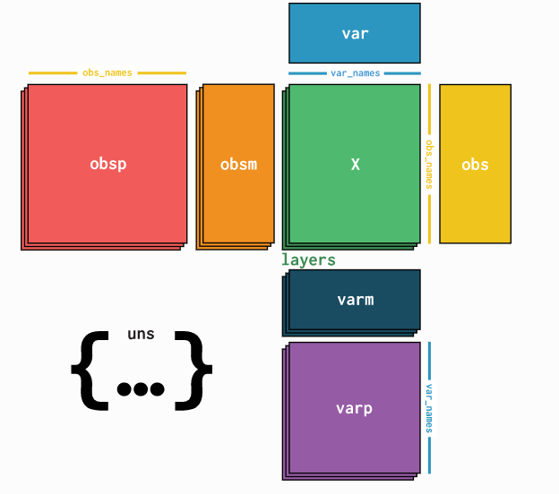
Merging of VDJ with Feature Barcode Matrix using ScanPy, Scirpy and AnnData
Anndata is a Python package for handling annotated data matrices

Slide 22
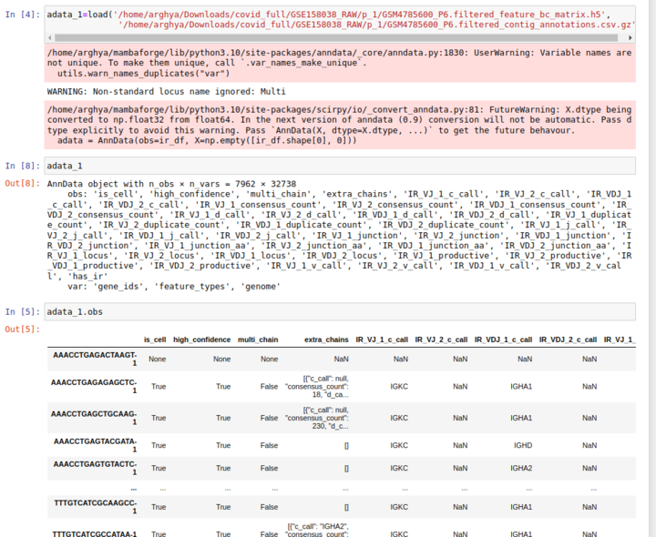
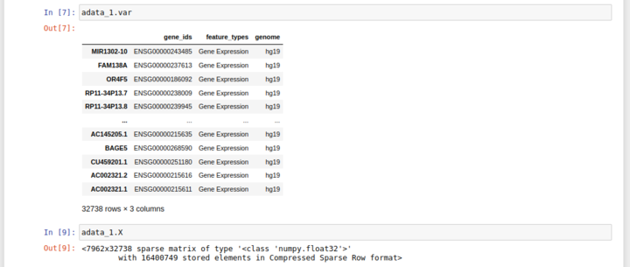

Slide 23
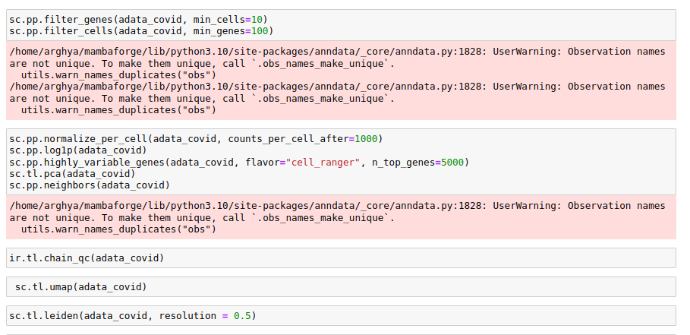
Pre- processing steps

Slide 24
Pre- processing steps
Filtration
Normalization
Removing Highly Variable Genes
PCA
Clustering
UMAP

Slide 25
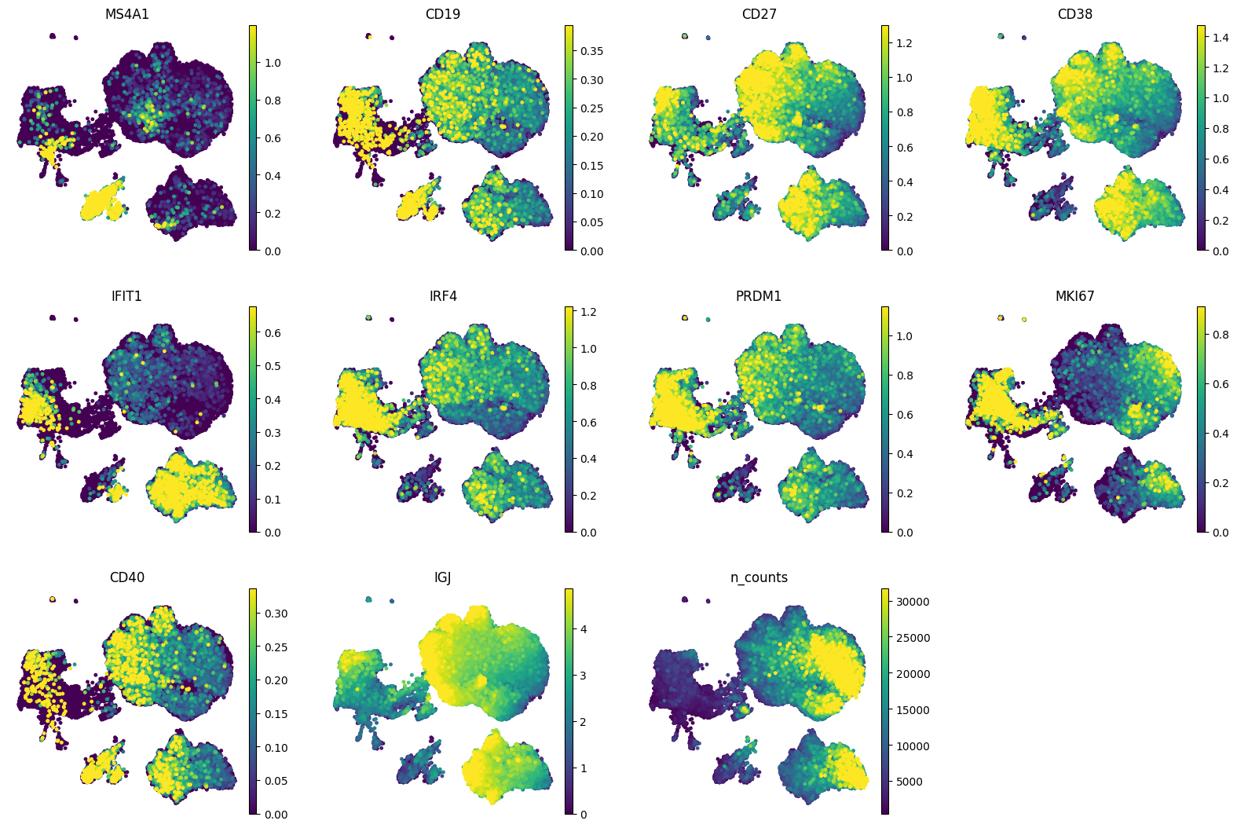
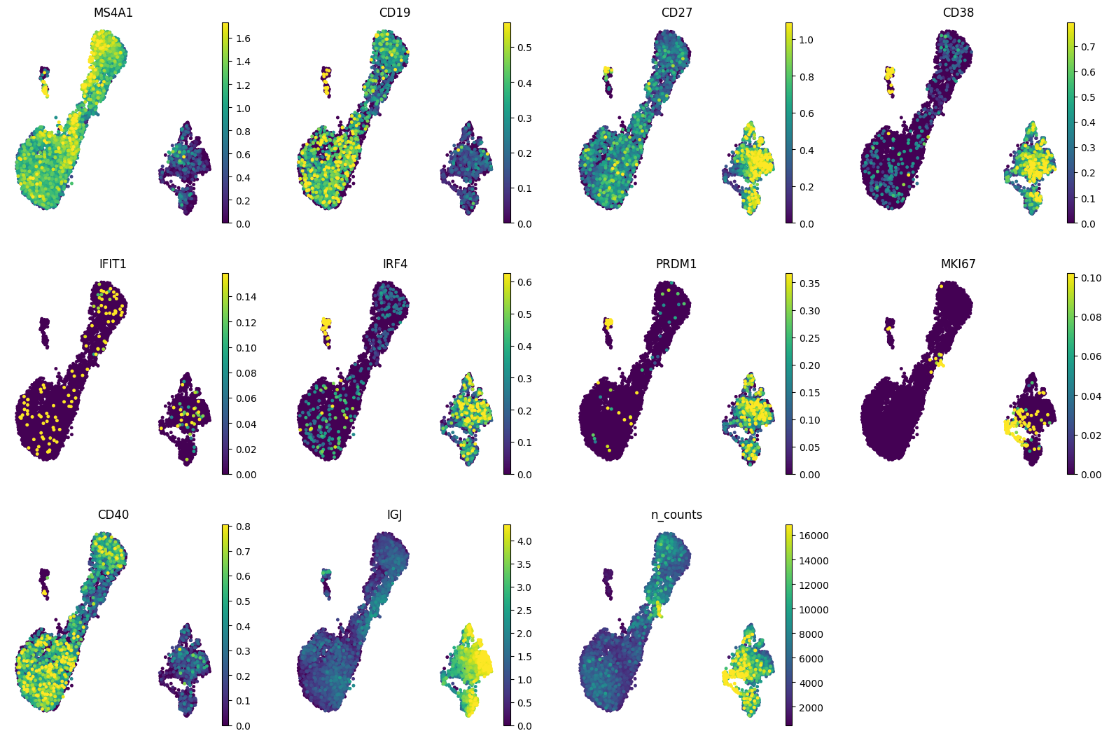
Mapping
Covid
Covid
Covid
control

Slide 26
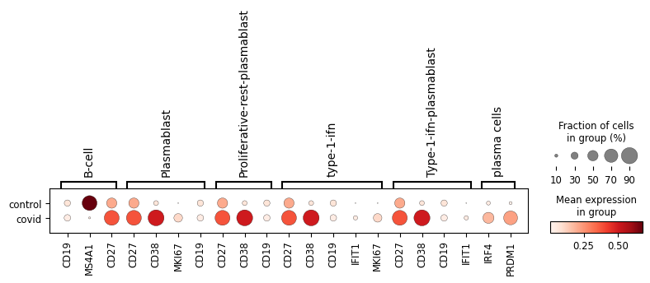
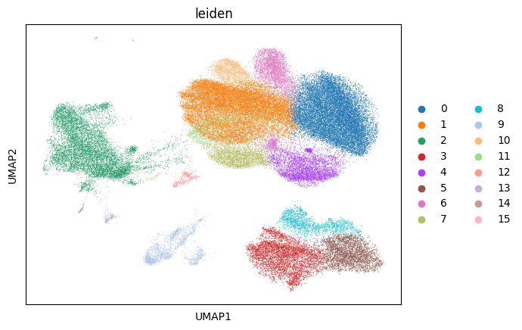
Cell Type Annotation of Marker Genes
PLASMA CELLS
B CELLS
TYPE 1 IFN PLASMABLAST

Slide 27
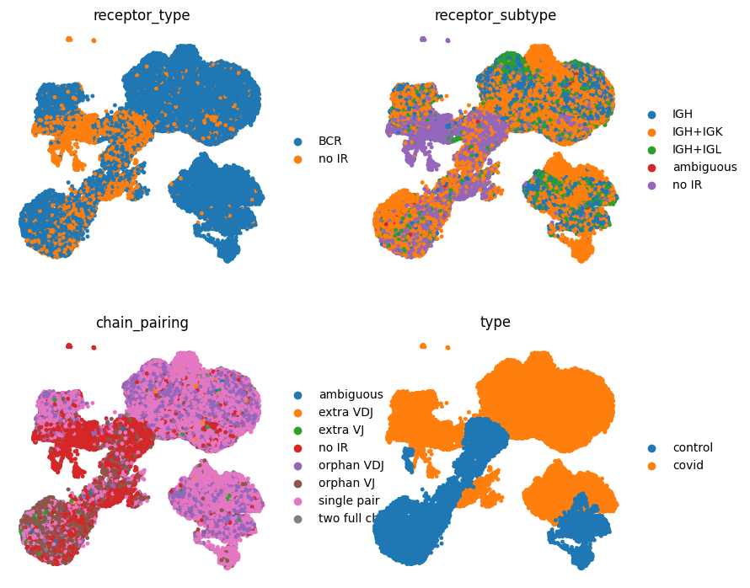
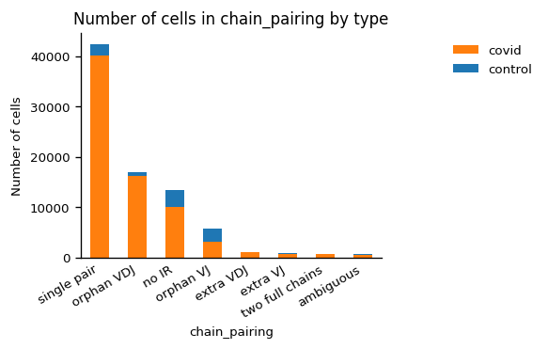
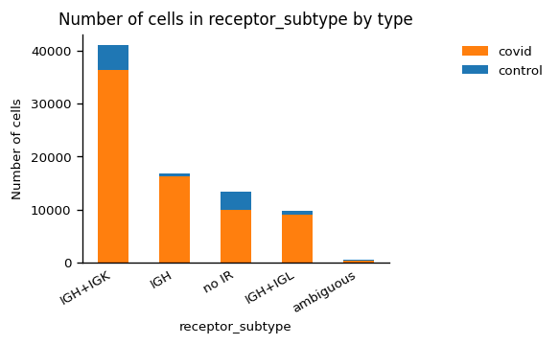
When B cells encounter a foreign antigen such as the covid virus that causes COVID-19, they can undergo clonal expansion and produce large quantities of Ig molecules that can specifically bind to the virus and help to neutralize it.
The abundance of IGH and IGK genes could indicate the presence of clonal populations of B cells that have undergone expansion in response to the virus.
The analysis of the diversity and expression patterns of these genes could provide insights into the specificity and strength of the immune response to the virus, as well as the potential for developing therapeutics such as monoclonal antibodies.

Slide 28
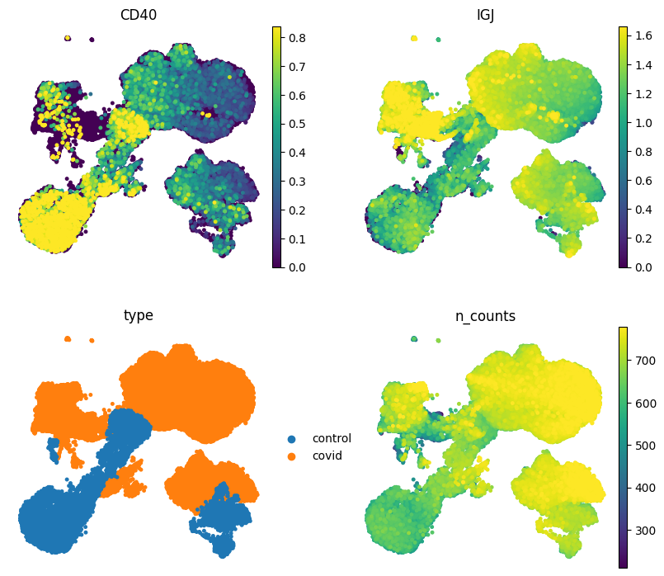
Specific markers and their expression level within both cohorts-
Activation and function
CD40 - a co-stimulatory molecule that is involved in B cell activation and antibody production.
CD40 expression is upregulated in some covid patients and may be a potential therapeutic target.
In healthy individuals, CD40 is important for B cell activation and the production of antibodies.
IGJ - a protein involved in the assembly of immunoglobulins.
Reduced levels of IGJ have been observed in some COVID-19 patients, potentially reflecting impaired antibody production.
In healthy individuals, IGJ is important for the assembly and secretion of antibodies.

Slide 29
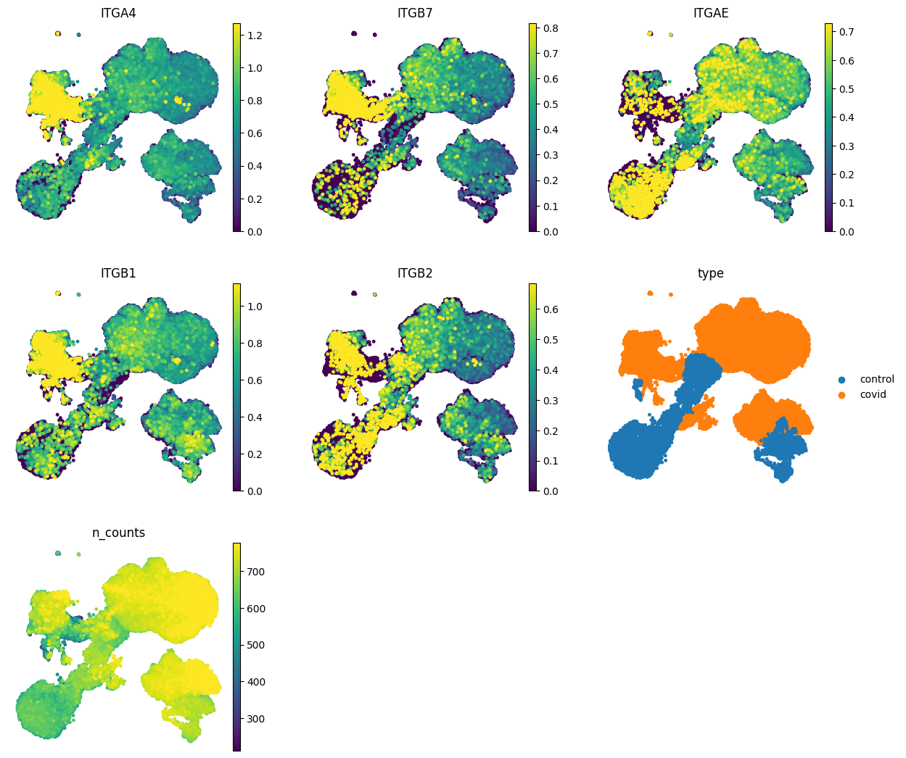
2. Integrins
ITGA4 and ITGB1 are involved in leukocyte adhesion and migration.
upregulated in the lung tissue of patients with covid, increased expression of ITGA4 has been associated with severe disease and poor clinical outcomes, while blockade of ITGB1 has been shown to reduce lung inflammation and improve lung function in covid.
ITGB2 is expressed on leukocytes and is involved in leukocyte adhesion and migration.
upregulated in the lung tissue of covid patients, and inhibition of ITGB2 has been shown to reduce lung inflammation in animal models of covid.
ITGAE and ITGB7 are expressed on intraepithelial lymphocytes in the gut, and are involved in maintaining gut barrier integrity and regulating the immune response to gut antigens.
They have been implicated in the pathogenesis of gastrointestinal symptoms in covid, as well as in the gut inflammation observed in severe covid cases.

Slide 30
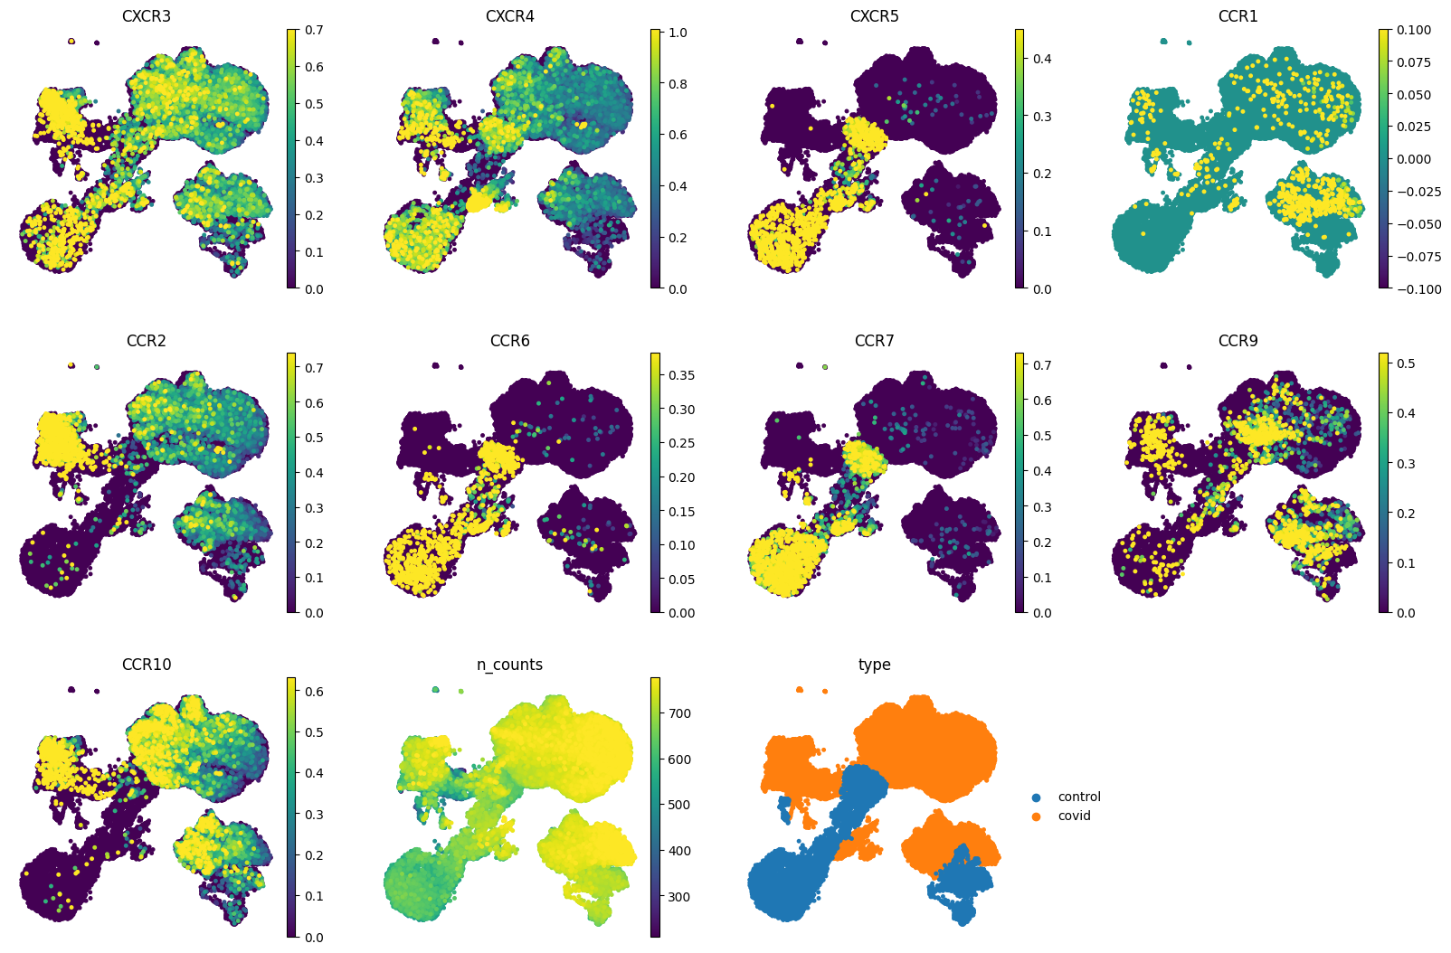
3. Chemokine receptors
CXCR3: This receptor is expressed by NK cells and T cells that can migrate to the lungs and cause inflammation and tissue damage.
CXCR3+ NK cells and T cells were reduced in peripheral blood but increased in bronchoalveolar lavage fluid (BALF) of COVID-19 patients, suggesting that they were recruited to the lungs.
CXCR4: This receptor is expressed by various hematopoietic cells, including T cells, B cells, dendritic cells and macrophages.
CXCR4+ CD8+ T cells were increased in peripheral blood of COVID-19 patients compared to healthy controls, and that they had higher expression of activation markers and cytotoxic molecules.
CXCR5: This receptor is expressed by B cells and follicular helper T (Tfh) cells that are involved in lymphocyte homing and lymphoid tissue development.
CXCR5+ Tfh cells were decreased in peripheral blood of COVID-19 patients compared to healthy controls, and that they had lower expression of IL-21, a cytokine that promotes B cell differentiation and antibody production.
CCR1: This receptor is expressed by monocytes, macrophages, neutrophils, eosinophils, basophils, mast cells, dendritic cells and some T cell subsets.
CCR1 expression was higher in severe COVID-19 patients than in mild or asymptomatic cases.
CCR2: This receptor is expressed by monocytes, macrophages, dendritic cells and some T cell subsets.
CCR2+ monocytes were increased in peripheral blood of COVID-19 patients compared to healthy controls, and that they had higher expression of inflammatory cytokines and chemokines.
CCR6: This receptor is expressed by dendritic cells, B cells, T cells and NK cells.
CCR6+ CD4+ T cells were decreased in peripheral blood of COVID-19 patients compared to healthy controls, and that they had lower expression of IL-17A, a cytokine that promotes mucosal immunity,also CCR6 is involved in the migration of dendritic cells to lymph nodes.
CCR7: This receptor is expressed by naive and central memory T cells, B cells and dendritic cells.
CCR7+ CD8+ T cells were increased in peripheral blood of COVID-19 patients compared to healthy controls, and that they had higher expression of activation markers and cytotoxic molecules.

Slide 31
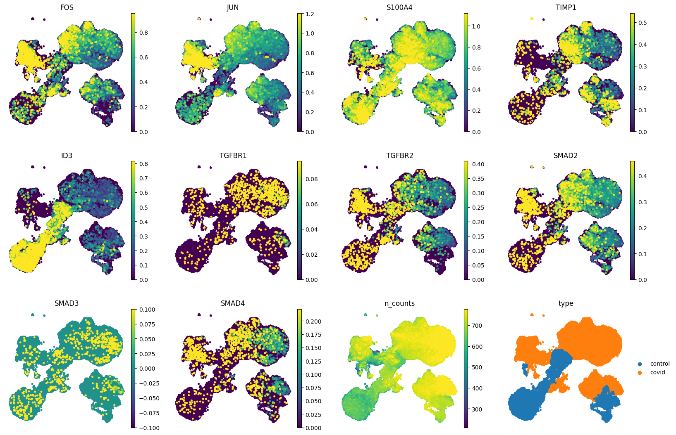
4. stat3/smad associates - molecules that interact with each other and regulate cellular processes such as growth, differentiation and tumorigenesis.
STAT3 stands for signal transducer and activator of transcription, which is a protein that transmits signals from the cell membrane to the nucleus.
Smad3 stands for Sma and Mad related protein , which is a protein that operates downstream of growth factors such as TGF-β.
STAT3 can selectively interact with Smad3 and antagonize TGF-β signaling, which means it can reduce the effects of TGF-β on the cell
FOS and JUN: involved in regulating gene expression.
In COVID-19, dysregulated cytokine production and T cell dysfunction have been observed, which could potentially involve FOS and JUN.
S100A4: This gene encodes a calcium-binding protein that is involved in a variety of cellular processes, including inflammation and tissue remodeling.
Elevated levels of S100A4 have been observed in covid-19 and it may play a role in the cytokine storm .
TIMP1: This gene encodes a tissue inhibitor of metalloproteinases, which regulate extracellular matrix remodeling.
In COVID-19, excessive extracellular matrix remodeling could contribute to lung damage, and TIMP1 may play a role in regulating this process.
ID3: This gene encodes a transcription factor that regulates cell differentiation and proliferation.
In COVID-19, T cell dysfunction has been observed, which could potentially involve ID3.
TGFBR1 and TGFBR2: These genes encode receptors for the cytokine transforming growth factor beta (TGF-β).
In COVID-19, excessive TGF-β signaling could contribute to lung fibrosis and other complications.
SMAD2, SMAD3, and SMAD4: These genes are downstream effectors of TGF-β signaling and regulate gene expression.
. In COVID-19, dysregulated SMAD signaling could contribute to lung fibrosis and other complications.

Slide 32
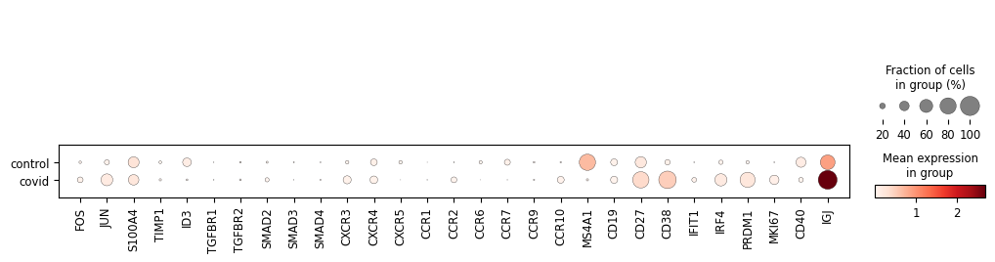
Now , we have to visualize the expression level of each gene/receptor in both cohorts so as to understand the difference across conditions.

Slide 33
Differential gene expression
Differential gene expression refers to differences in the level of expression of genes between different biological conditions, such as healthy and diseased tissue or different developmental stages of an organism. Here, we have 15 clusters so we have compared each cluster to the rest and ranked based on the score.
Wilcoxon test
And, to view the genes more concisely, we can make a dot plot

Slide 34
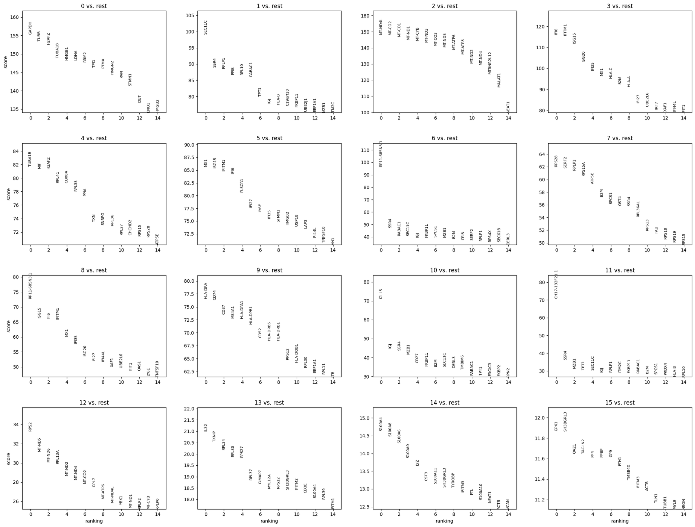

Slide 35
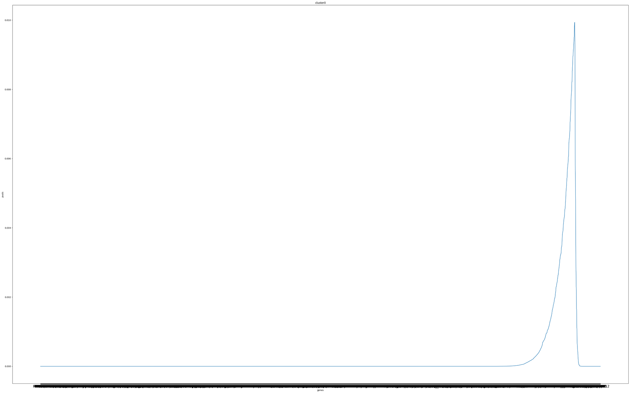
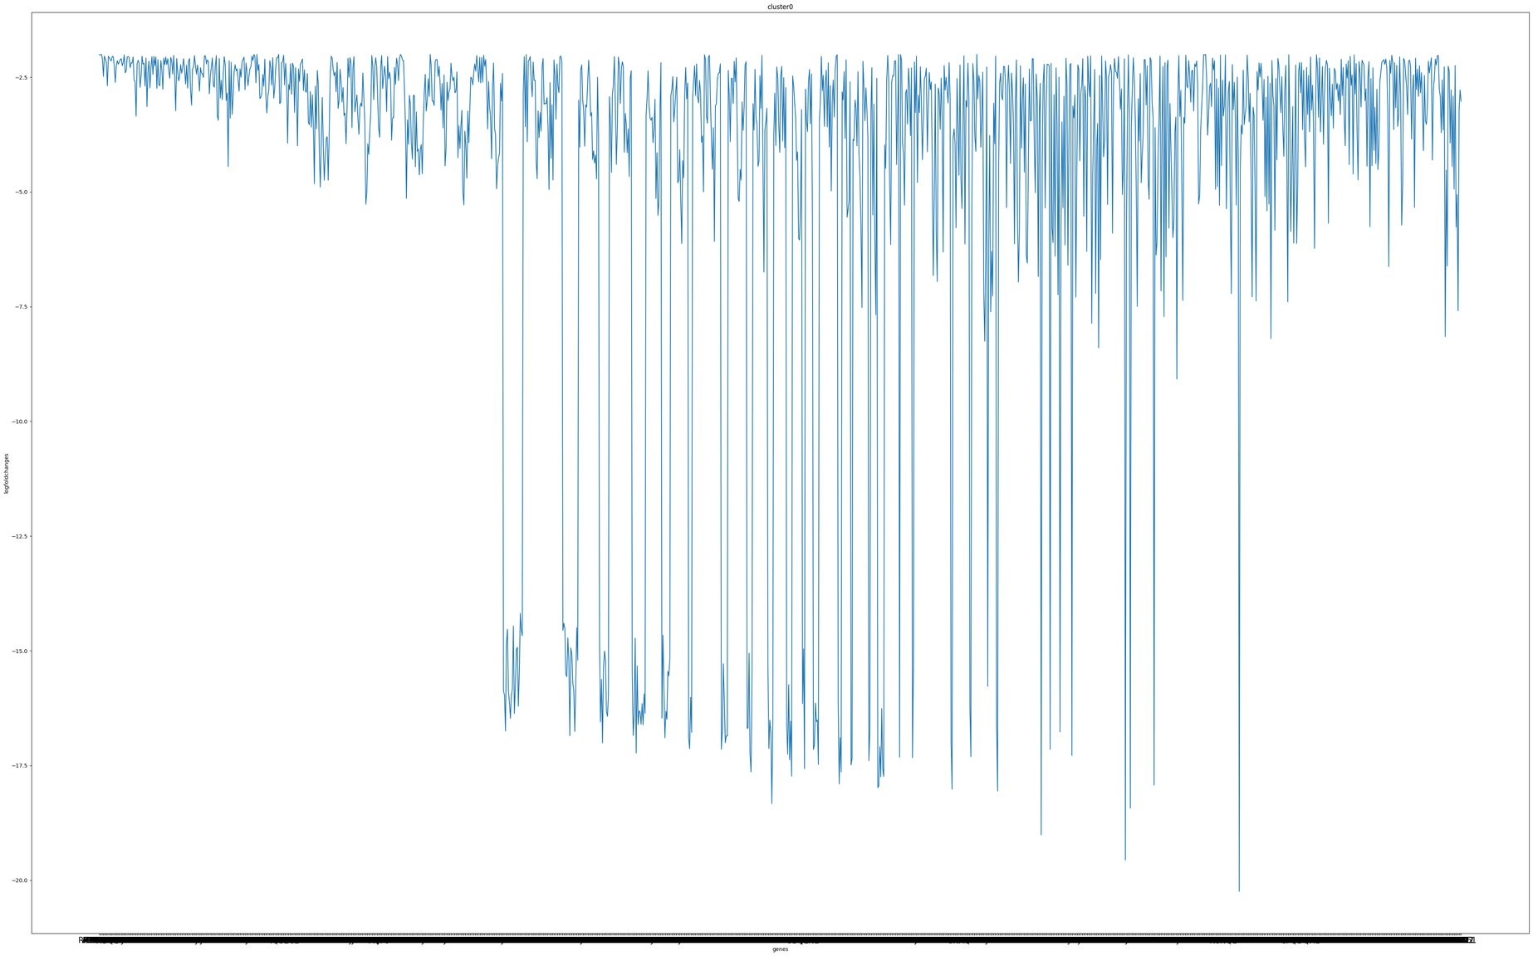
Now, we apply the threshold -
p value<0.01; measure of the statistical significance of the observed difference in gene expression between the two groups. (A small p-value indicates that the observed difference is unlikely to have occurred by chance, and suggests that the gene is differentially expressed between the two groups.)
FDR >log2(1.3);a measure of the magnitude of the difference in gene expression between the two groups. It is defined as the log2 ratio of the mean expression in one group compared to the other. A positive log fold change indicates that the gene is upregulated in the first group compared to the second group, while a negative log fold change indicates that the gene is downregulated. The magnitude of the log fold change reflects the degree of upregulation or downregulation of the gene.
basically, p-value and log fold change can be used to identify genes that are both statistically significant and biologically relevant.
log fold change > log2(1.3) . X axis- genes; Y axis - log fold change ; for cluster 0
pval- 0.01. X axis- genes; Y axis - pval ; for cluster 0

Slide 36
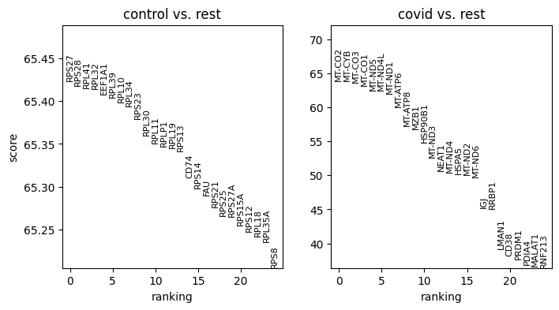
Similarly, we will perform the same across condition i.e covid and control; which will give us a better idea of the differences

Slide 37
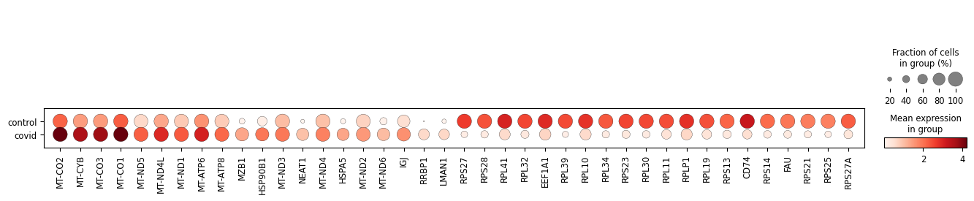
Now, since we got a lot of genes so we downsampled each cohort to 200 counts so as to observe and detect in a better way the top differentially expressed genes
By performing dge, we find out the expression profile of various other genes those were not mentioned in the literature. Also this includes a lot of mitochondrial and ribosomal genes which wasn’t removed to as to keep in check the sanity of the paper

Slide 38
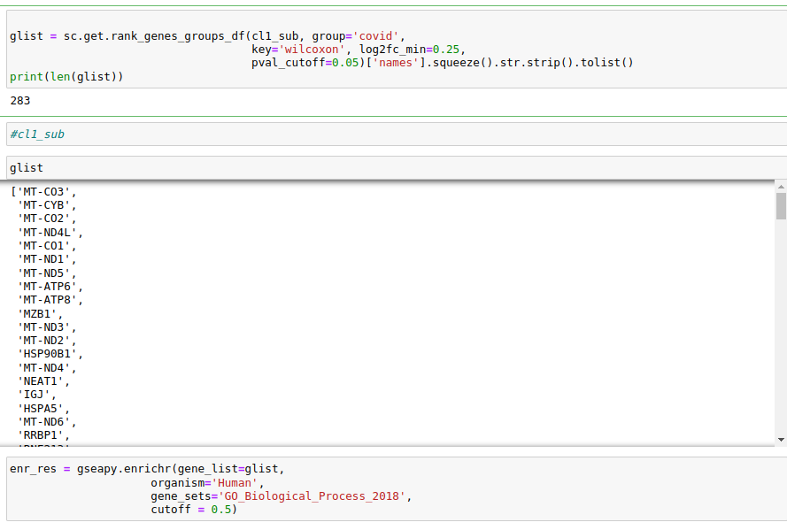
GSEA
works by ranking all genes based on their differential expression between two conditions.Then, it tests whether a predefined gene set is enriched for genes that are differentially expressed towards the top or bottom of the ranked list. This approach differs from traditional enrichment analysis, which only considers whether a gene set is enriched among differentially expressed genes, regardless of their position in the ranked list.used to identify biological pathways and gene ontology groups that are differentially regulated in a wide range of conditions
Here, we make a list of the top genes of dge and then use the gseapy enricher for enrichment of each gene set in the list of differentially expressed genes.
the list of differentially expressed genes is ranked in terms of a metric associated to the observed expression change. The ranked gene list is compared to a gene set, i.e., a list of genes known to be associated with a certain biological process, gene ontology (GO), molecular function or pathway. The metric is needed to calculate the enrichment score (ES) that indicates the degree by which a gene set is overrepresented at the extremes of the ranked list

Slide 39
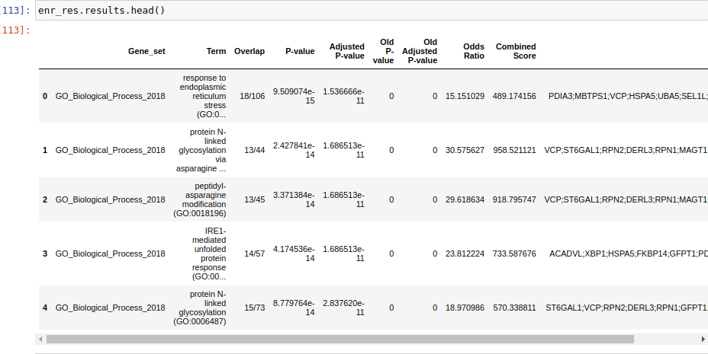
This gives us a list of all the major pathways and the genes involved for the same

Slide 40
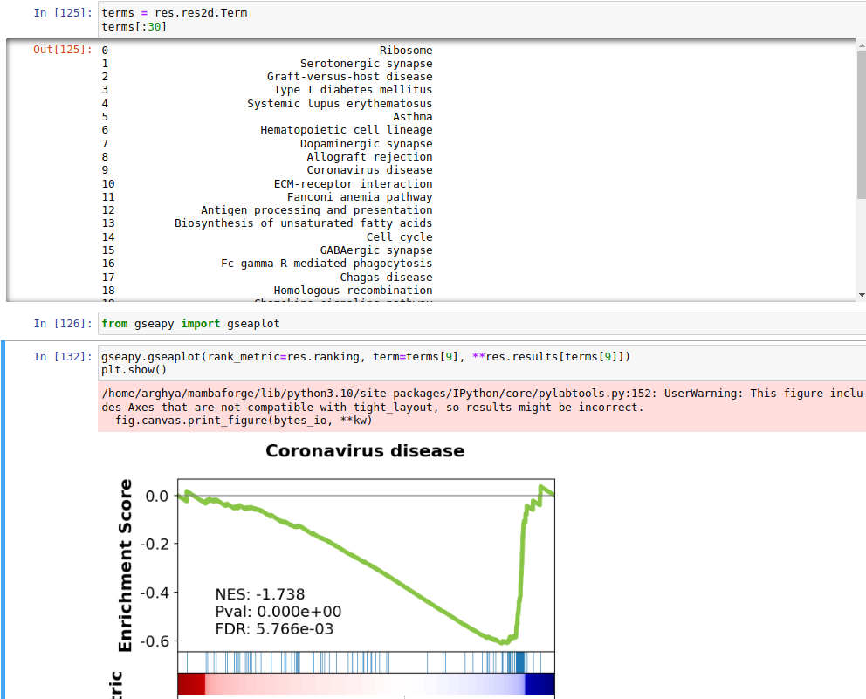
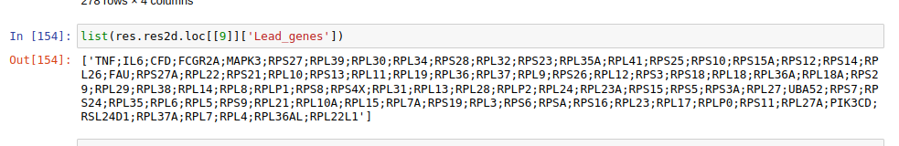
We rank our genes and compare it to a predefined set of our choice(KEGG_2021_Human'); to get the pathways and the lead genes present in our sample according to dge followed by gseapy
the GSEA results pointed out to the evidence of “cell cycle” among enriched pathways

Slide 41
Future steps
Clonotype analysis
Different cell annotation techniques
Extracting immune receptor data from various file formats
Epitope Specificity analysis
Explore more of gsea

